Slide 1


CITS1003 Introduction to Cybersecurity [0] Unit overview
Dr Jin Hong

Slide 2
3 Things
Understand the objectives and structure of this unit
01
Understand the technical requirements and role of the practical component
02
Understand the “rules” or ethics of cybersecurity and this unit
03

Slide 3
Pre-Requisites and Target Audience
There are hundreds of students enrolled in the unit from diverse backgrounds
There will be minimal coding (unless you want to do more) in this unit and no assumption of prior knowledge in computer science or mathematics
This is an introductory course and so suitable for anyone wishing to familiarise themselves with the terms, concepts and practical aspects of Cybersecurity
The course is based on CyBOK - the Cybersecurity Book of Knowledge project (https://www.cybok.org/) and some elements of CISSP (Certified Information Systems Security Professional) from ISC²

Slide 4
Getting started
People
Emergency
Locations
Topics
Items of assessment
Online resources
FAQ
What is Cybersecurity?
Learning outcomes
Ethics

Slide 5

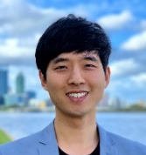
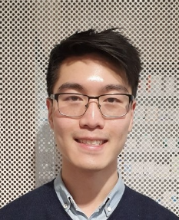
People
Jin Hong
Unit coordinator
Room 1.10
jin.hong@uwa.edu.au
Larry Huynh
Assistant Lecturer
Room ???
larry.huynh@.uwa.edu.au
Avery Warddhana
Lab facilitator
Room: ???
22984998@student.uwa.edu.au
Terra Tormey
Lab facilitator
Room: ???
21114519@student.uwa.edu.au
Aliah Al-shabib
Lab facilitator
Room ???
23139394@student.uwa.edu.au
Emma Paterson
Lab facilitator
Room ???
22734222@student.uwa.edu.au
Mia Blessas
Lab facilitator
Room: ???
23295523@student.uwa.edu.au
Hass
Admin team
Room: Main reception
admin-csse@uwa.edu.au

Slide 6
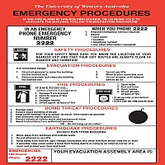
Emergency
General emergency: call campus security at 6488 2222
In super emergency: call emergency at 000
In all buildings, we have an emergency procedure such as this picture ->
Please take a time and read it.
For more details, please have a read through our emergency procedure for various potential incidents
http://www.safety.uwa.edu.au/incidents-injuries-emergency/procedures

Slide 7
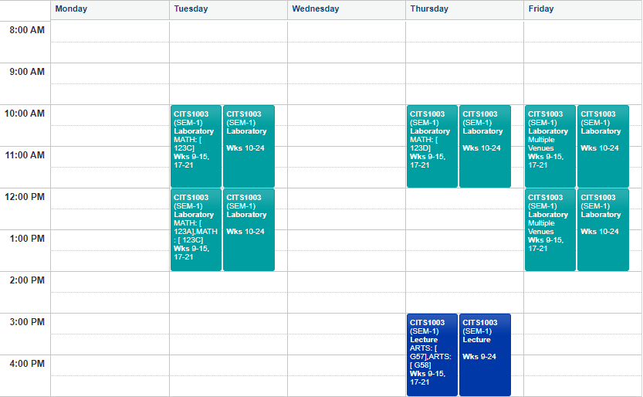
Location
Notes:
Labs are both F2F and online i.e., hybrid (MS Teams call will be used for online students)
Lectures are "flipped" – you should watch the video lectures prior to coming to the scheduled lecture

Slide 8
Location
Lectures
Content lectures are all available online right now (all 12 weeks worth of lectures!)
Go at your own pace (but don't get behind the schedule!)
Come to the scheduled lecture for interactive discussions, demos, in-class exercises.
Labs – labs in MATH123 and MS Teams
Check your timetable for the lab allocation
You may go to another scheduled lab IFF there is a room (normally there is)
https://studentvip.com.au/uwa/main/maps/129665
Labs will start from week 2
Office hours
Maybe Wed 12 – 2pm (F2F, virtual can be arranged) -> this is just an arbitrary slot
Other times can be arranged too (send an email or message on Teams to book)
But I am also okay students rocking up anytime as long as I am free while I am in
For lab enquiries, please:
Ask on Teams (but remember not to share answers)
Ping lab facilitators on Teams (you can contact any one of them)!
If all fails, contact me via email

Slide 9
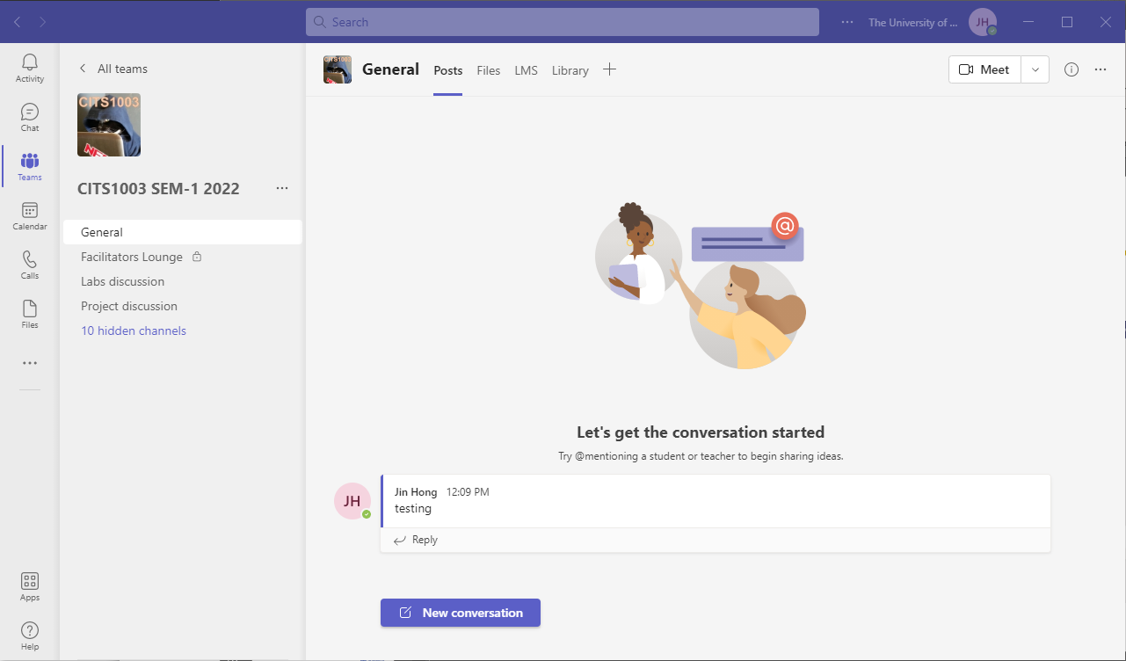
Location

Slide 10
Topics
Introduction to overall definitions and concepts of information security, the CIA triad, vulnerabilities, threats and risk
Cryptography: codes and ciphers
Computers and Networks
Threats
Vulnerabilities
Security management
Incidents
Forensics
Critical Infrastructure and Cyber Physical Systems
Cyber Law
AI and Cybersecurity

Slide 11
Labs
The labs rely on using a technology called Docker
As this technology is *not* available on UWA lab machines, it must be run on your laptops
If you do not have a laptop that is capable of running the labs, you can arrange to borrow one: https://uwacyber.gitbook.io/cits1003/cits1003-labs/introduction-to-labs
Else – invest in a decent laptop – it will make a big difference to your University life.
If none of these options are available to you, please come and chat with me.
Labs start in Week 2.
There will be a companion Capture The Flag server where you will need to provide flags that you find during the labs as evidence that you have completed them
Labs are worth 25% of assessment.

Slide 12
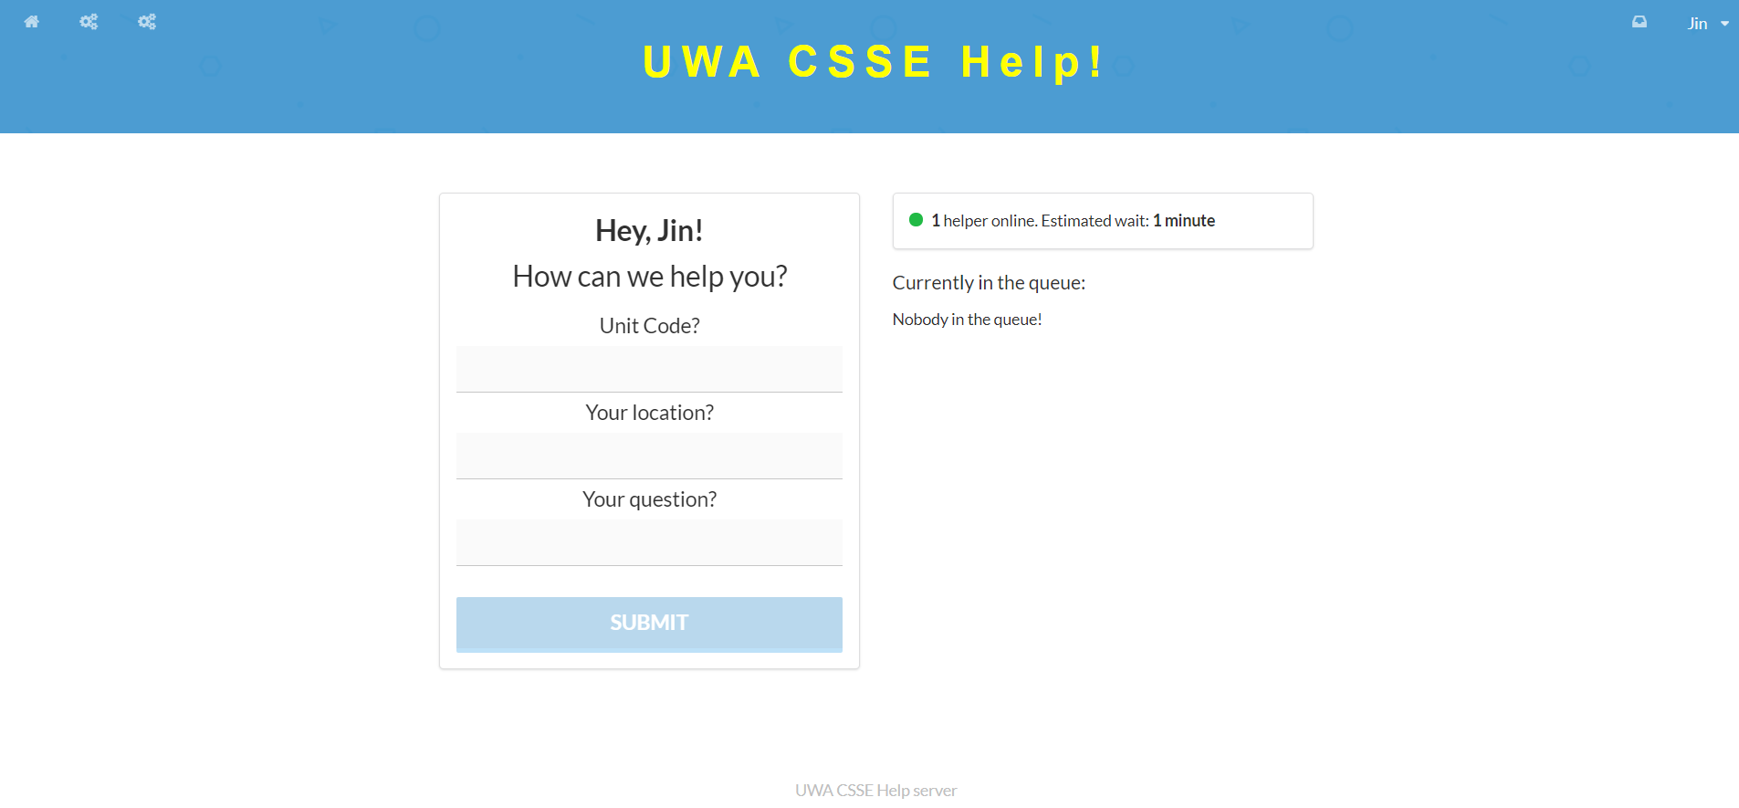
Labs – Help server

Slide 13
Labs – Help server
For labs, we will be using the help server, which allow students to queue to get help
This means no fighting over who put their hands up first
Online people can get noticed better!
Please note, You won't get help outside the scheduled lab hours!
How it works:
Login to the help server at: https://help.jinhong.org/
by default, you use your student ID with temporary password “helloworld”
You can change your password once you login (you have to re-login after)
Any issues logging in, contact any of the facilitators or the UC
Fill out the form and wait until a facilitator comes to you!
Note: for the location, write the desk number for F2F students, and "online" for online students.
If you are doing labs via online, then the facilitator will contact you via Teams!

Slide 14
Other Assessment
Project released in Week 6 (TBC) and ending in Week 10 (TBC). This will be similar in format to the labs – except without the guidance part
Project is worth 25% of assessment
Final Exam: 50% of final assessment
Exam overview will be done in week 12.

Slide 15
Online Resources
You may find David's book on Ethical Hacking with Hack The Box useful
https://book.ethicalhackinghtb.xyz/
Other useful online resources will be provided throughout the weeks as necessary.

Slide 16
FAQ - Lectures
Q: Some lecture videos are not clear (e.g., visual, audio), can you remake them?
A: Contact me about the issue and I will review it.
If there are technical faults, I will remake them.
If it is about clarity of the contents, and many of you found the same issue, it will also be addressed
Otherwise it will be explained in person
Q: I want to learn about [______], can it be covered?
A: I will take suggestions to add that content into CITS1003.

Slide 17
FAQ - Labs
Q: Why labs take too long to finish?
A:
Labs are to get you familiar with various cybersecurity concepts, and it could take longer than the allocated 2 hours for the lab to finish it.
You are welcome to attend other scheduled labs (given there is a room for extra students) to complete the labs with a help of lab facilitators.
Q: Why don’t we get sample answers for labs (and others)?
A:
The lab solutions for this unit can be different significantly from one to another, even with reasonably simple questions.
We simply don’t want you to learn sample answers, but rather learn to explore various ways of solving (i.e., improve problem solving skills).
We (facilitators and lecturers) are happy to discuss your solution, work out what might be going wrong and try to fix it with you.

Slide 18

Cheating
Please don’t cheat on any of the assessment items.
Don’t copy your friend’s code.
Don’t copy code from online.
Don’t share your code structure with your friends
Only share ideas
Consequences are dire!

Slide 19
Information Security
All human endeavour relies on information
Business, Government, Education, Research, Personal life
Information security is about protecting this information from “unauthorised access, harm or misuse”¹
This is done by preserving Confidentiality, Integrity and Availability of information

Slide 20
What is Cybersecurity?
Cybersecurity is a subset of Information Security that concerns the digital realm – so:
Cyber security refers to the protection of information systems (hardware, software and associated infrastructure), the data on them, and the services they provide, from unauthorised access, harm or misuse. This includes harm caused intentionally by the operator of the system, or accidentally, as a result of failing to follow security procedures.¹
CIA is sometimes extended to include Authentication, Accountability, Non-Repudiation and Reliability

Slide 21
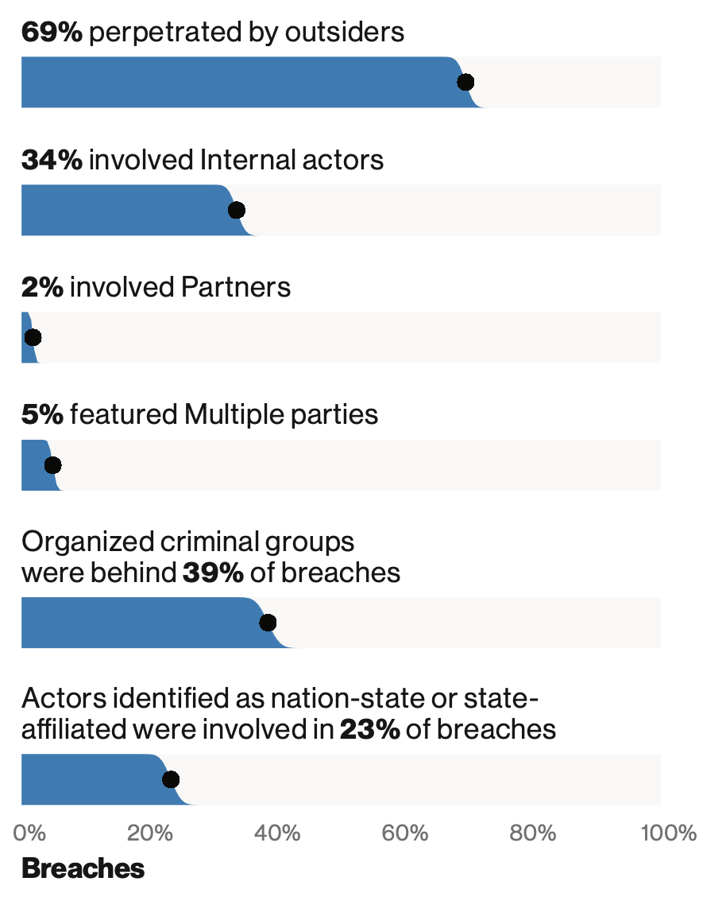
Human Threats
2018 breaches

Slide 22
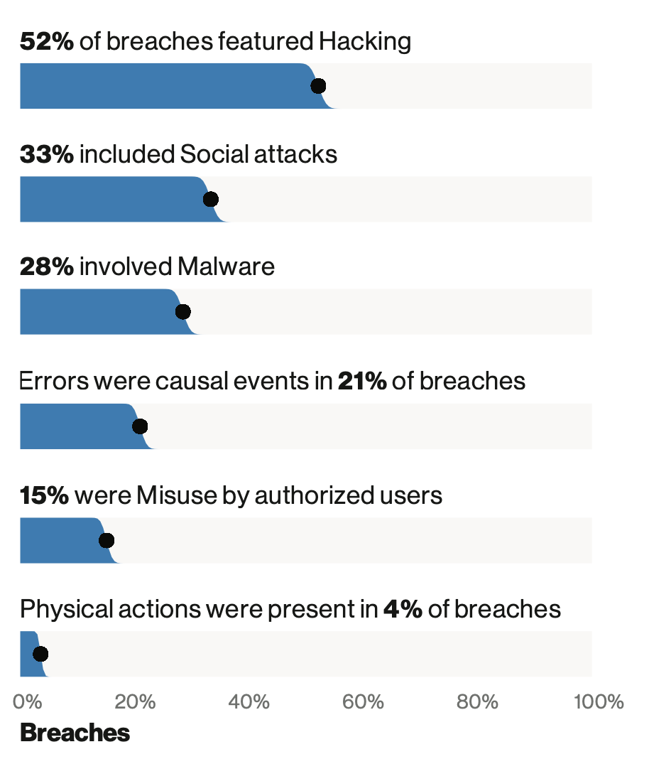
Human Exploits
2018 breaches

Slide 23
Learning Outcomes
To understand and be able to articulate
The language of Cybersecurity
The principles of preserving Confidentiality, Integrity and Availability
Principles of Risk Management
Cybersecurity in the domains of
* Human organisational and regulatory aspects, * Attacks and Defences, * System Security, * Software and Platform Security, * Infrastructure Security
Case studies will be used to illustrate and concretise language, terms and concepts throughout
Practical laboratory work will assist in practical aspects of Cybersecurity

Slide 24
Ethics (or what you *absolutely* should not do)
Codes of Ethics are needed by all endeavours that are ”professions”. In cybersecurity, there are several organisations that have them
ISC²
Protect society, the common good, necessary public trust and confidence, and the infrastructure.
Act honourably, honestly, justly, responsibly, and legally.
Provide diligent and competent service to principals.
Advance and protect the profession.

Slide 25
Ethics continued…
Don’t do anything that you don’t have explicit authorisation to do
Being helpful and pointing out vulnerabilities to organisations is often problematic
Hacking without authorization is a crime in most countries
You can cause damage to yourself and others by being negligent
However that doesn’t stop you exploring, investigating and learning

Slide 26
Copyright notice
Commonwealth of Australia
Copyright Regulations 1969
WARNING
Materials in this unit (CITS2401 – Computer Analysis and Visualisation) have been reproduced and communicated to you by or on behalf of The University of Western Australia pursuant to Part VB of the Copyright Act1968 (the Act).
The material in this communication may be subject to copyright under the Act. Any further reproduction or communication of this material by you may be the subject of copyright protection under the Act.

